Slide 1
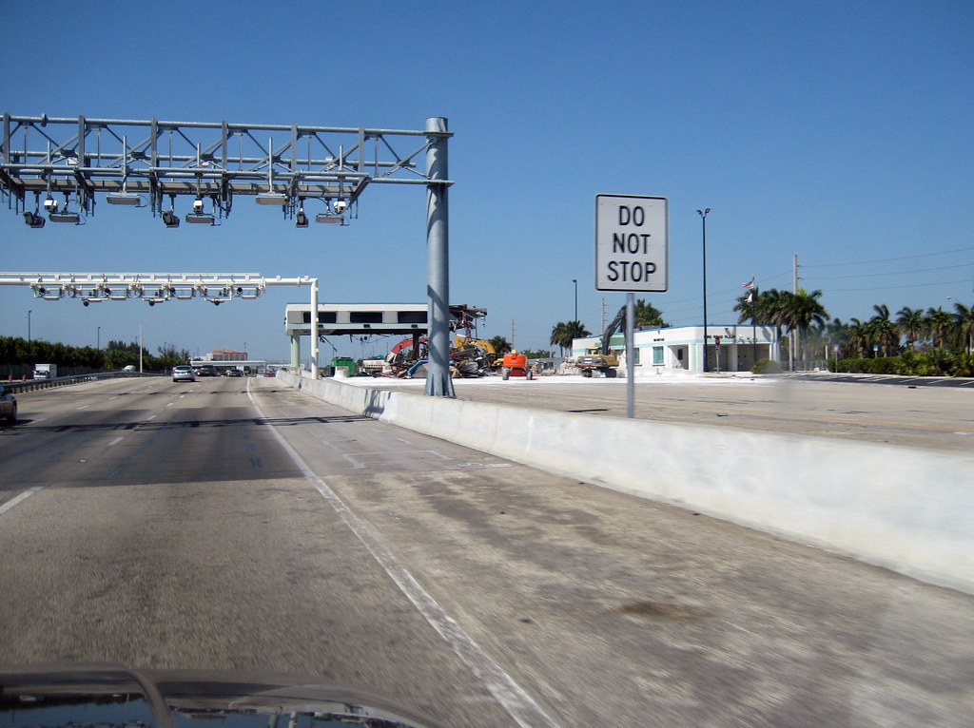
EXAMINING Us TOLL ROADS Extract-transform-load project
Thomas Creegan
Andre Ebanks
Sumita Jain
December 14, 2019

Slide 2
PROJECT SCOPE
Purpose: To illustrate the principles of Extract, Transform, Load (ETL)
Scope: Investigate historical costs and congestion of toll roads in the US
Extract latest available toll road data from the Federal Highway Administration and the Bureau of Transportation Statistics
Transform data by:
Cleaning – prepare CSV files to properly load in Pandas
Filtering – select relevant columns
Aggregating – combine data from multiple years
Load transformed data into a database that will allow users to compare two years of data to see how metrics such as cost per mile, number of miles of toll roads, population size, and Road Congestion Index relate

Slide 3
PROJECT methodology
3
Research data sources
Extract
Transform
Identified disparate data sources that would need to be combined to answer the questions
Data Source 1 – Federal Highway Administration -- data was a readily available csv file
Steps to clean, filter, aggregate, etc.
1
2
3
4
5
6
7
Define project scope
Develop db schema
Extract (continued)
Load
Conceived of a data problem that would require multiple data sources
Determined data elements required for a useful db
Identified primary keys
Data Source 2 – Bureau of Transportation Statistics – similar data was a readily available csv file
Developed Postgres db with 2 tables

Slide 4
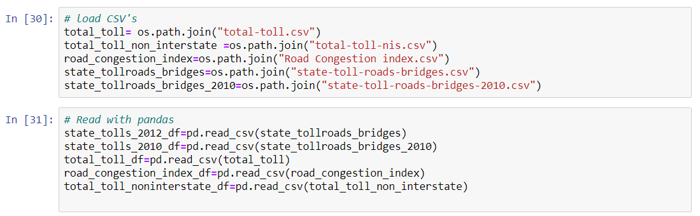
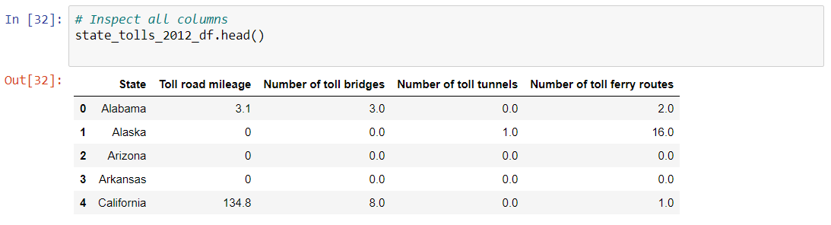
Extract (slide 1 of 2)

Slide 5
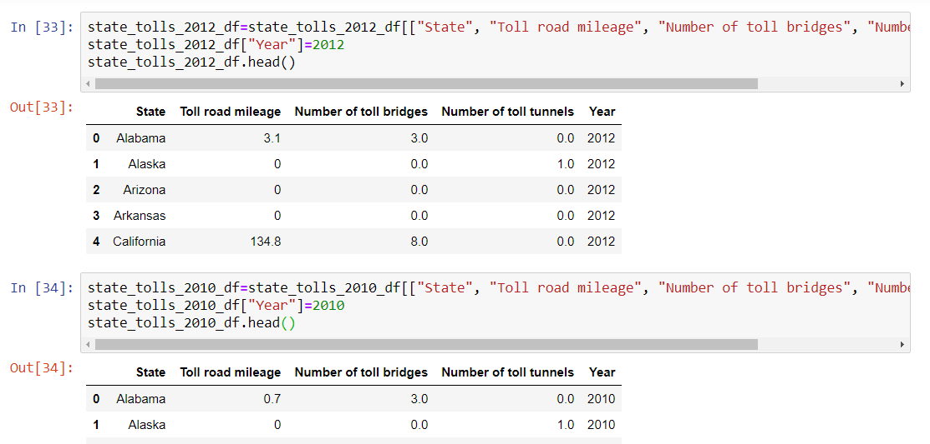
extract (slide 2 of 2)

Slide 6
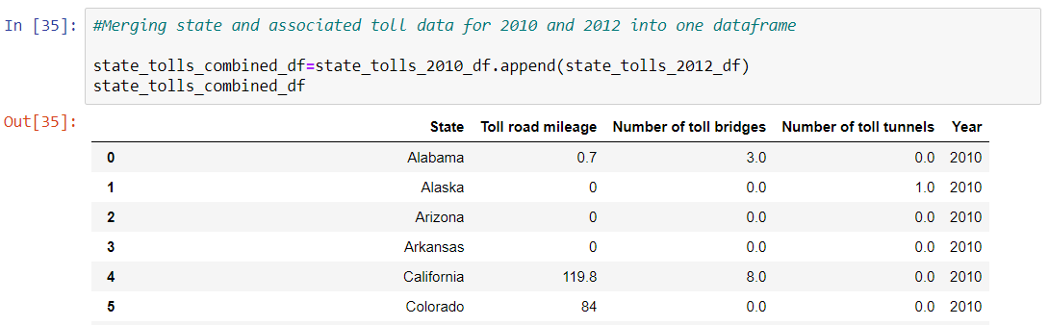
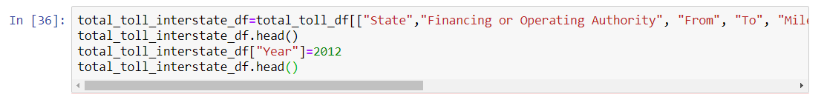
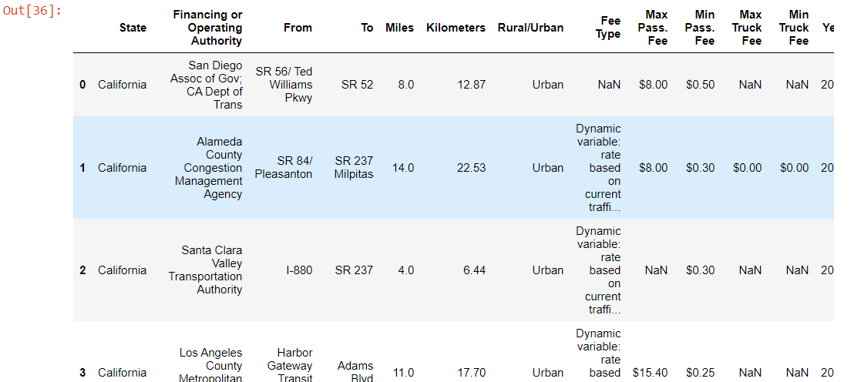
TRANSFORM (Slide 1 of 3)

Slide 7
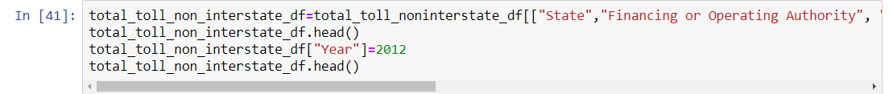
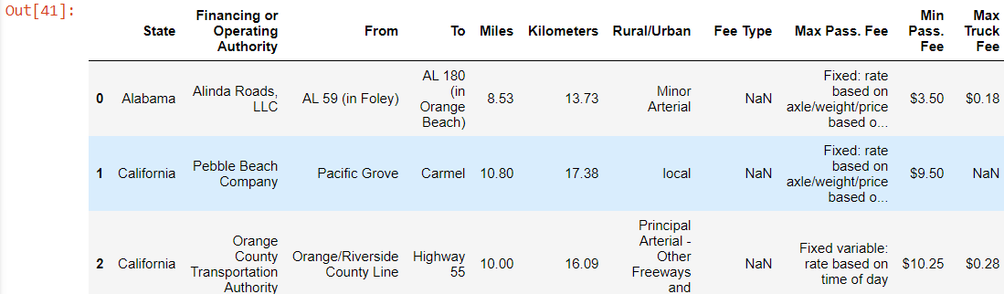
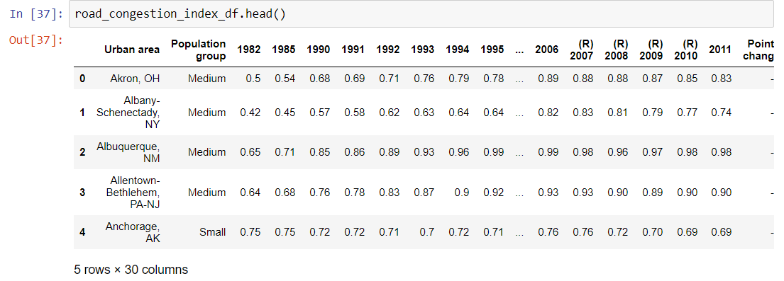
TRANSFORM (Slide 2 of 3)

Slide 8
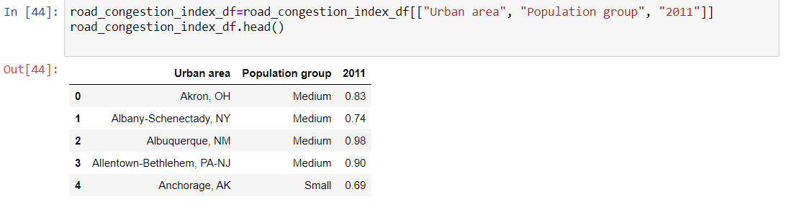
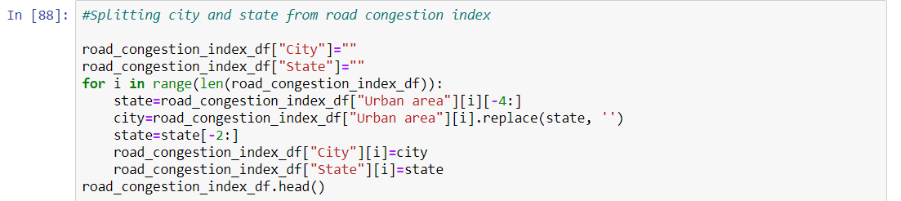
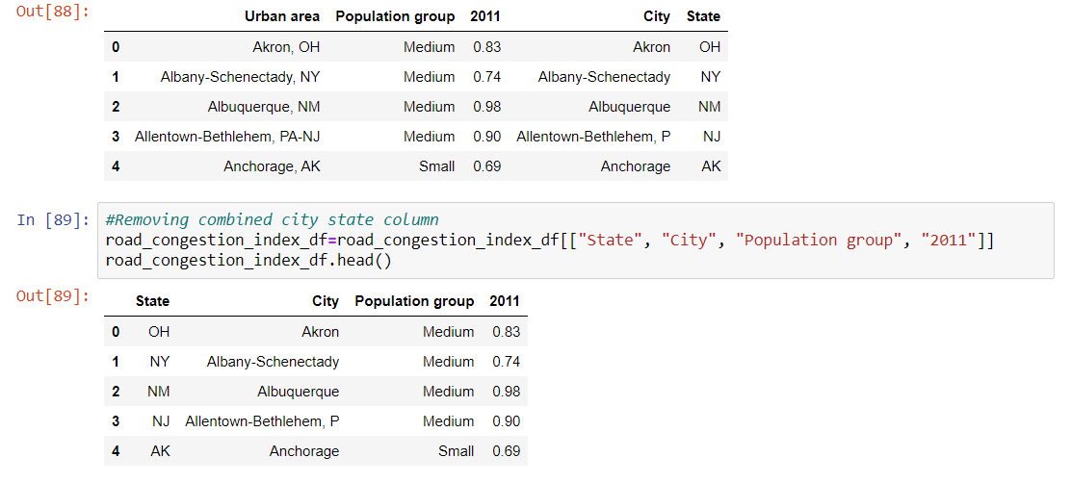
TRANSFORM (Slide 3 of 3)

Slide 9
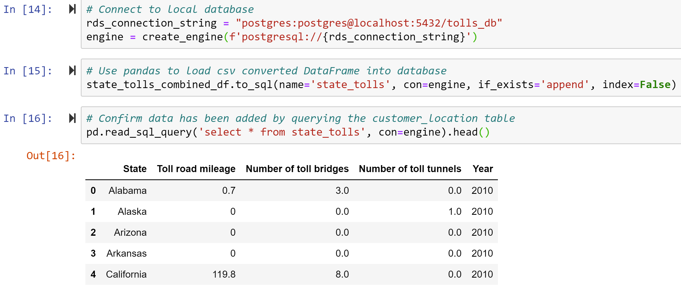
LOAD (Slide 1 of 5)

Slide 10
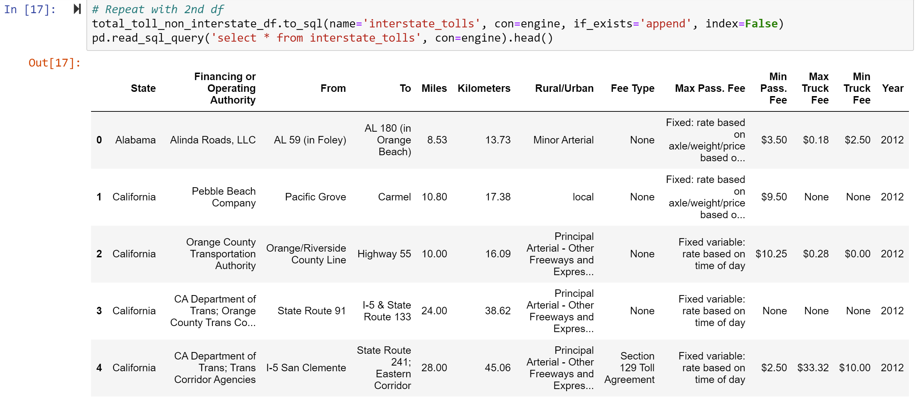
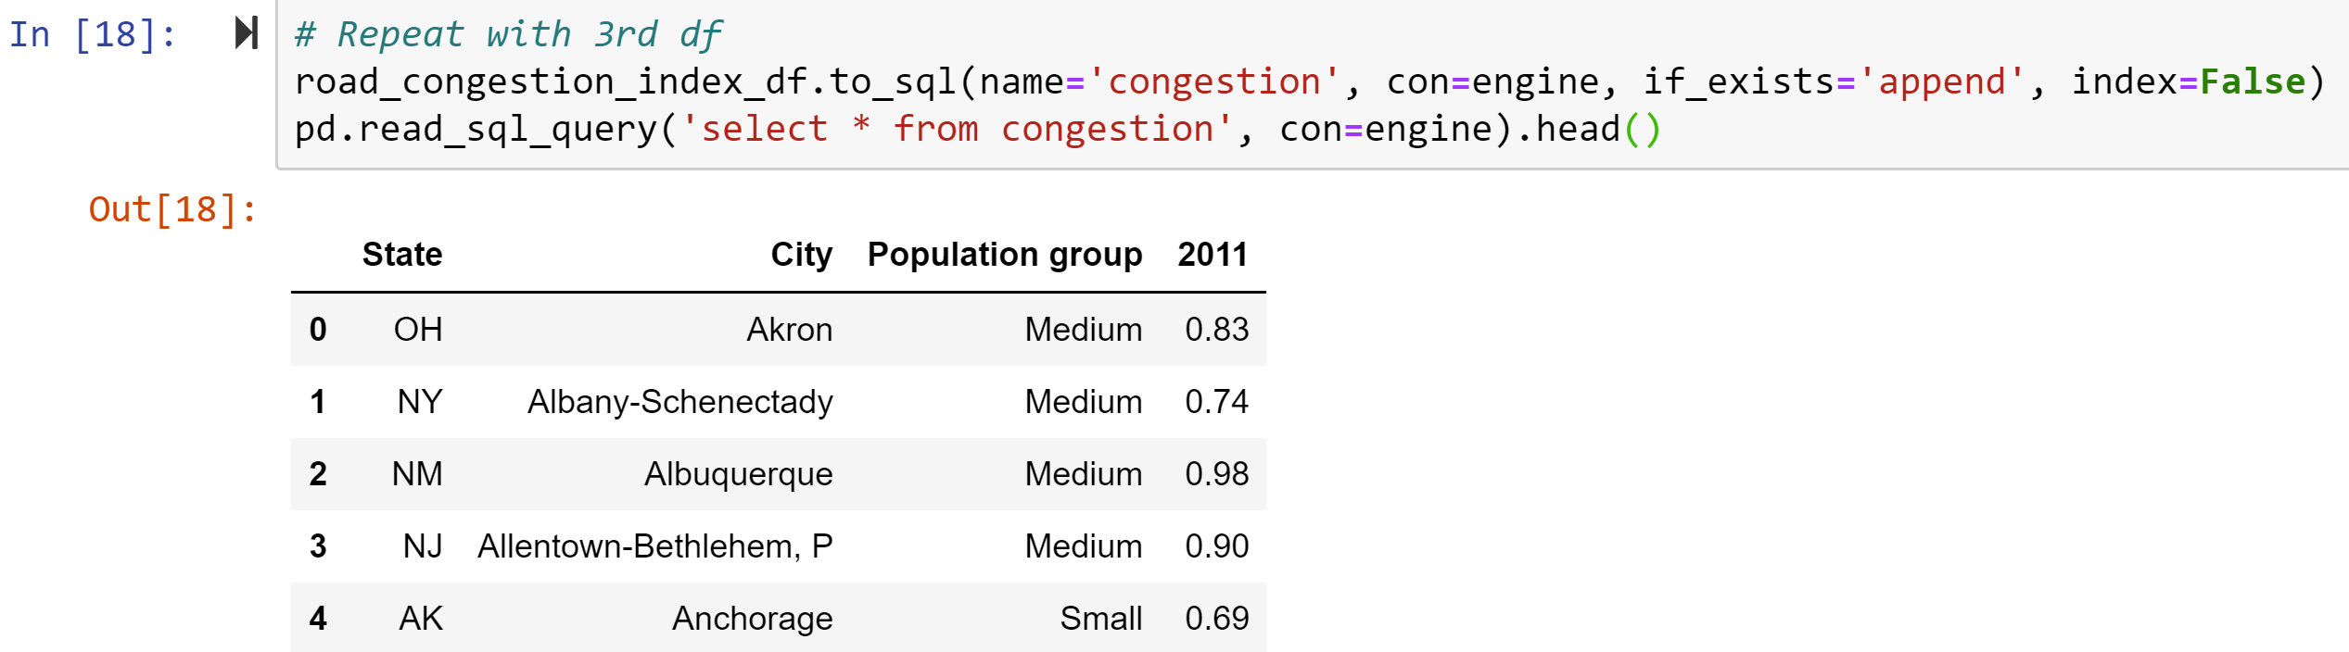
LOAD (Slide 2 of 5)

Slide 11
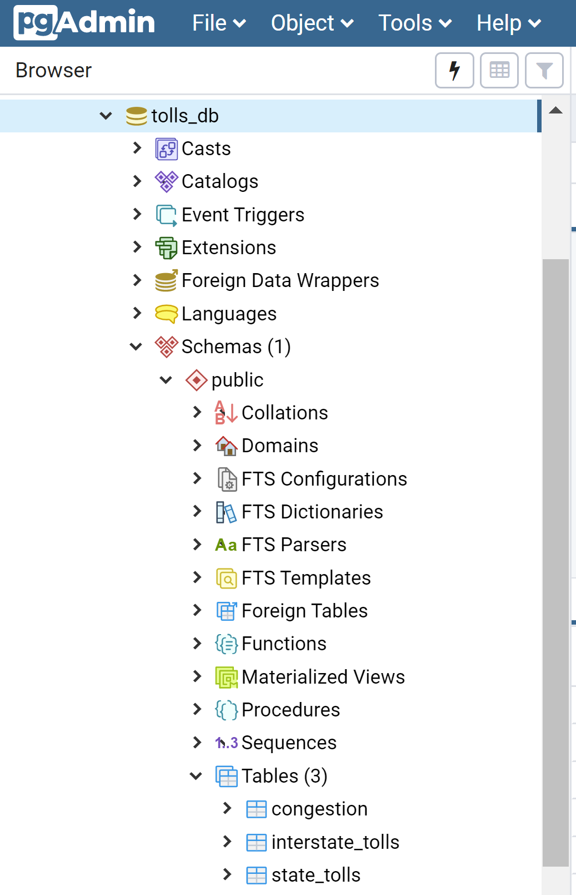
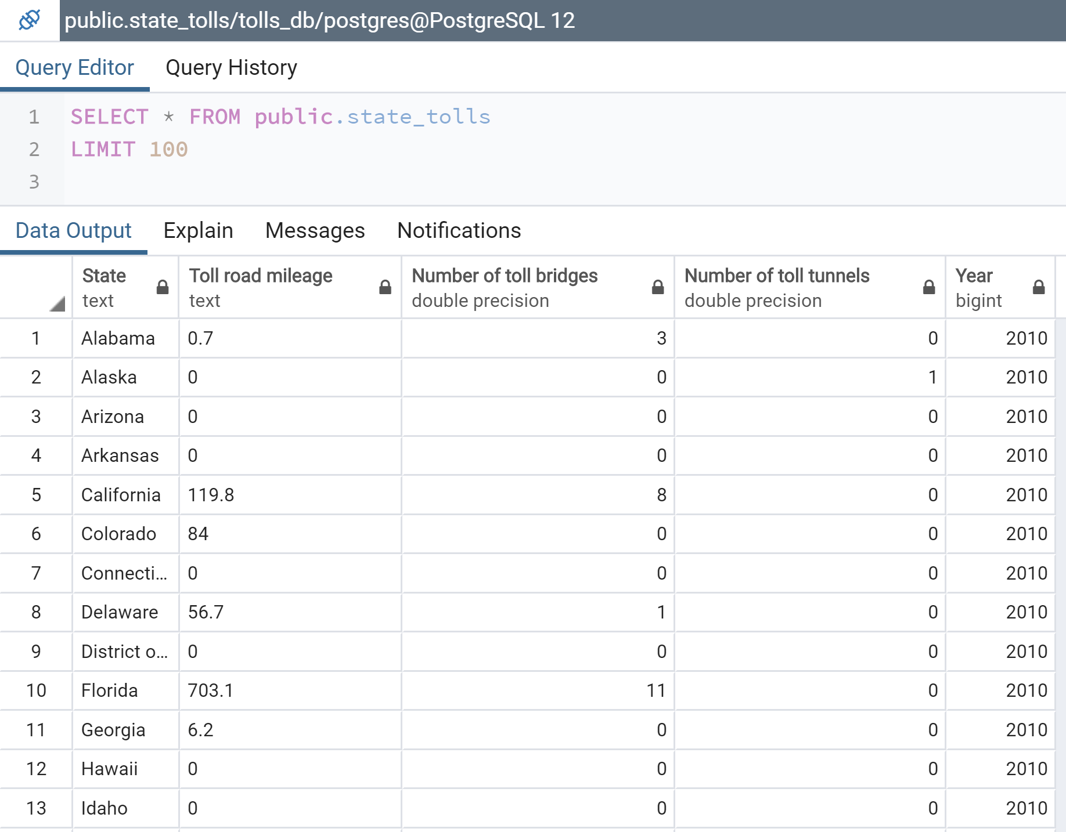
LOAD (Slide 3 of 5)

Slide 12
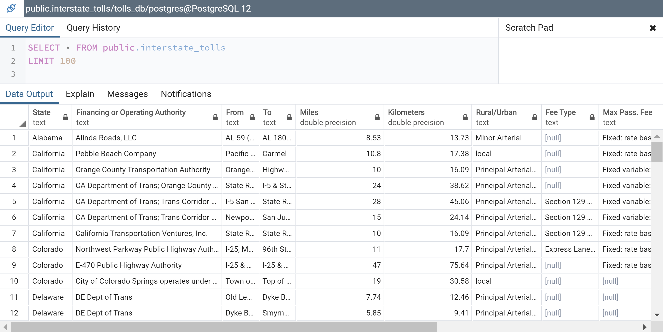
LOAD (Slide 4 of 5)

Slide 13
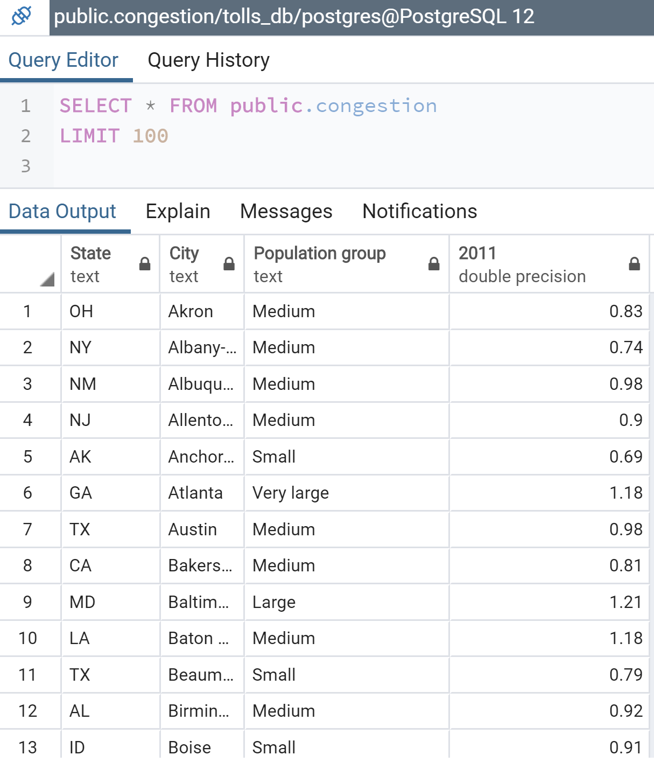
LOAD (Slide 5 of 5)

Slide 14
Reflections
There are many different tolling mechanisms (for example, congestion-based prices vs. fixed per mile prices)
As expected, even eight years ago, the Road Congestion Index was higher in urban areas
Creation of a more complete dataset was thwarted by the absence of current data on the elements examined
The original sources utilized did not provide more recent data
A commercial toll road website with current data and an API was identified, however, it did not contain similar data elements, thus there was no common field upon which to merge the datasets into a logical schema

